Slide 1
R & QGIS: Integrating Statistical and Spatial Data Analysis
Class 2: Statistical Data in QGIS

Slide 2
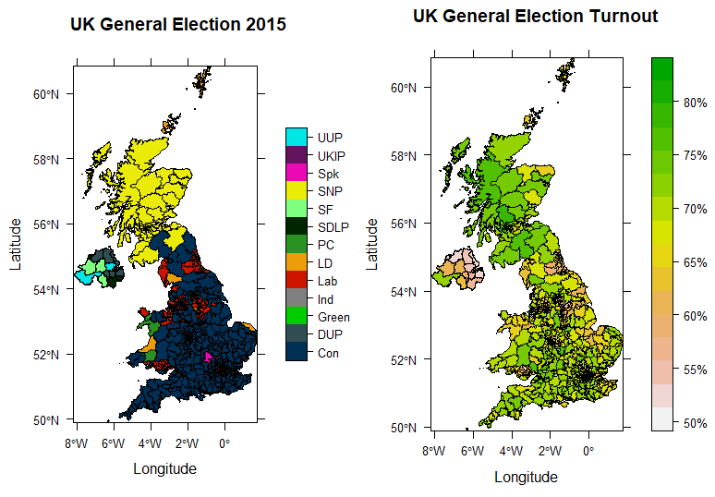
Before Starting…
Last Week’s Practical

Slide 3
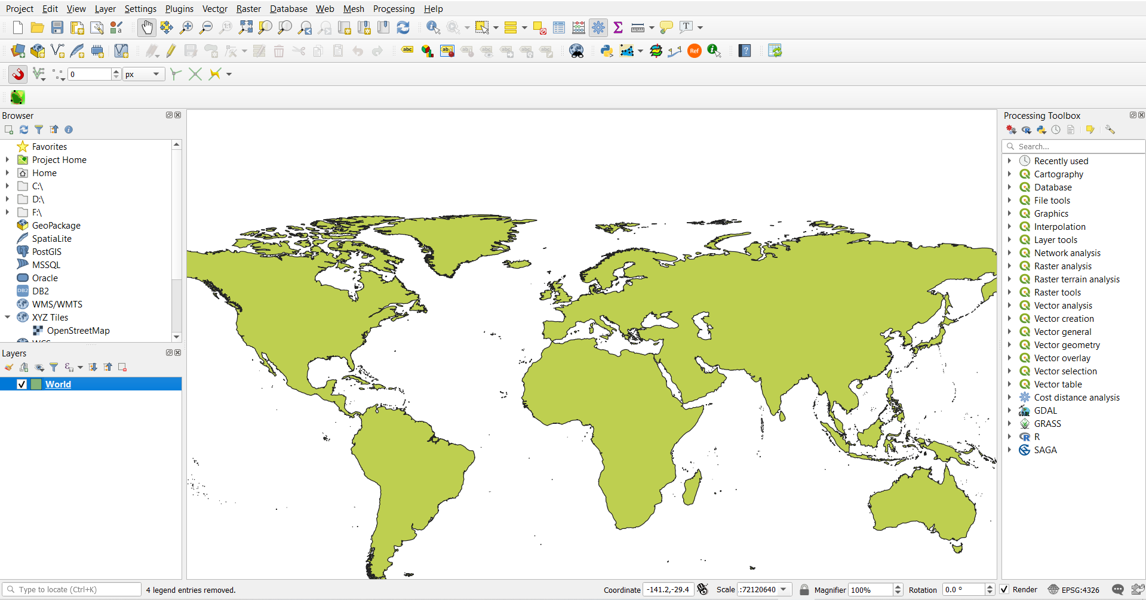
Spatial Data in QGIS
Fairly easy to import
Click and drag .shp (in folder with the other required files)
Layer/Add Layer/Add Vector Layer
Same basic process for Rasters (.tif)

Slide 4
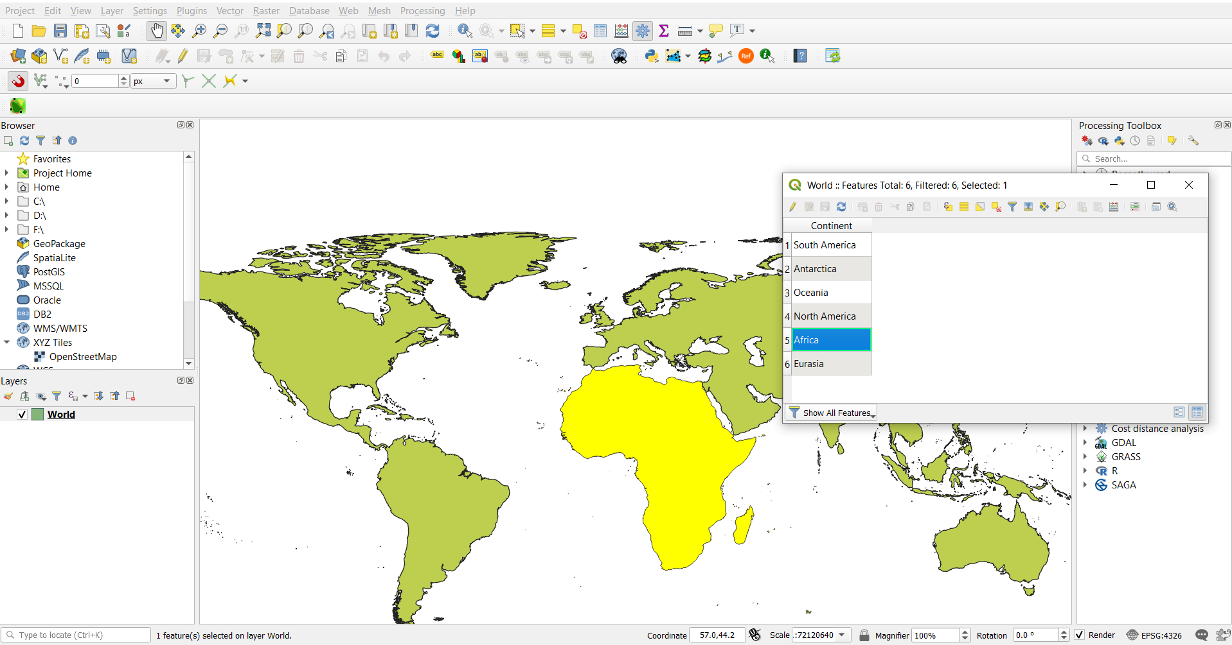
Statistical Data in QGIS
Any shapefile, right click ‘Open Attribute Table’ (or F6)
Select features in attribute table ‘Show Selected Features’ (or Shift + F6)
Zoom in, in attribute table ‘Show Features Visible On Map’ (or Ctrl + F6)

Slide 5
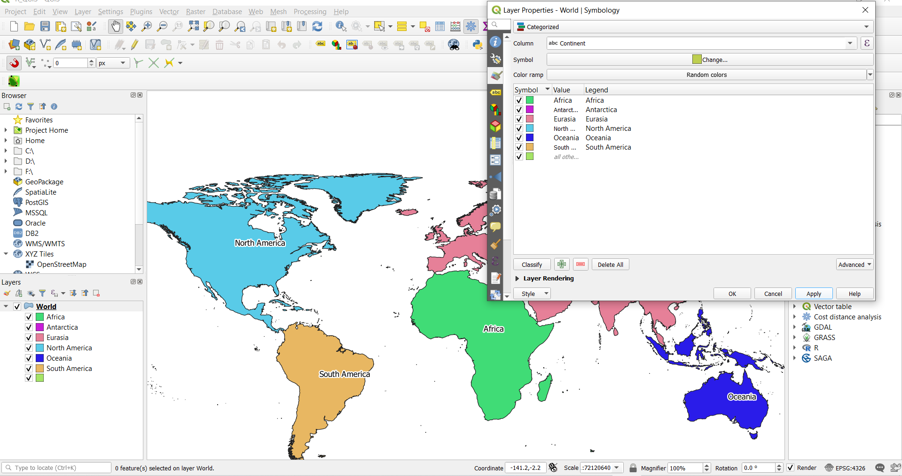
Visualising Statistical Data
Much like in R, we can visualise by colour
We can label with specific values from columns

Slide 6
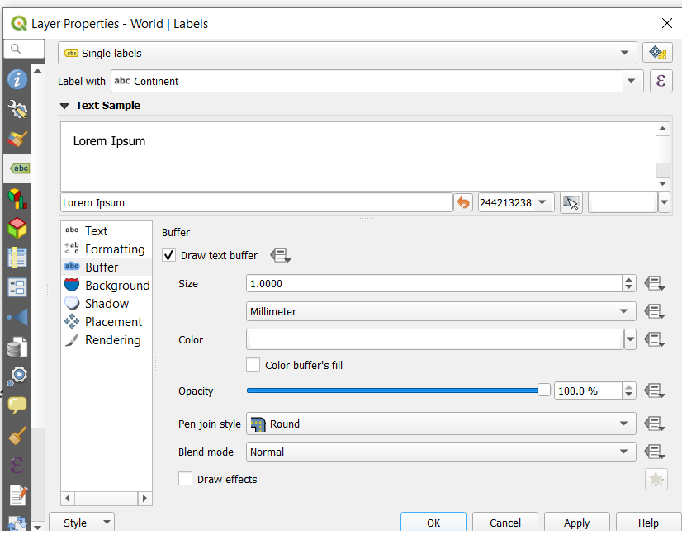
Visualising Statistical Data
Much like in R, we can visualise by colour
We can label with specific values from columns

Slide 7
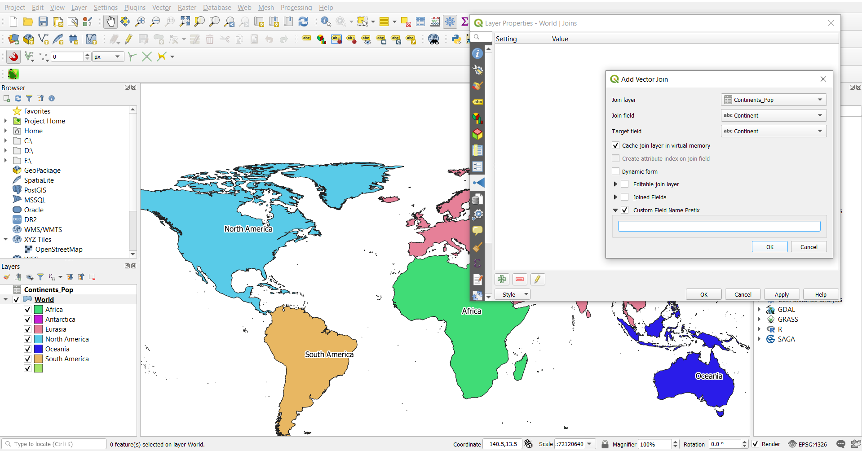
Joining Attributes from .csv
Import .csv
Right click Properties (or double click), Join
Join Layer= csv
Join/Target Field= Shared Column
Export new shapefile

Slide 8
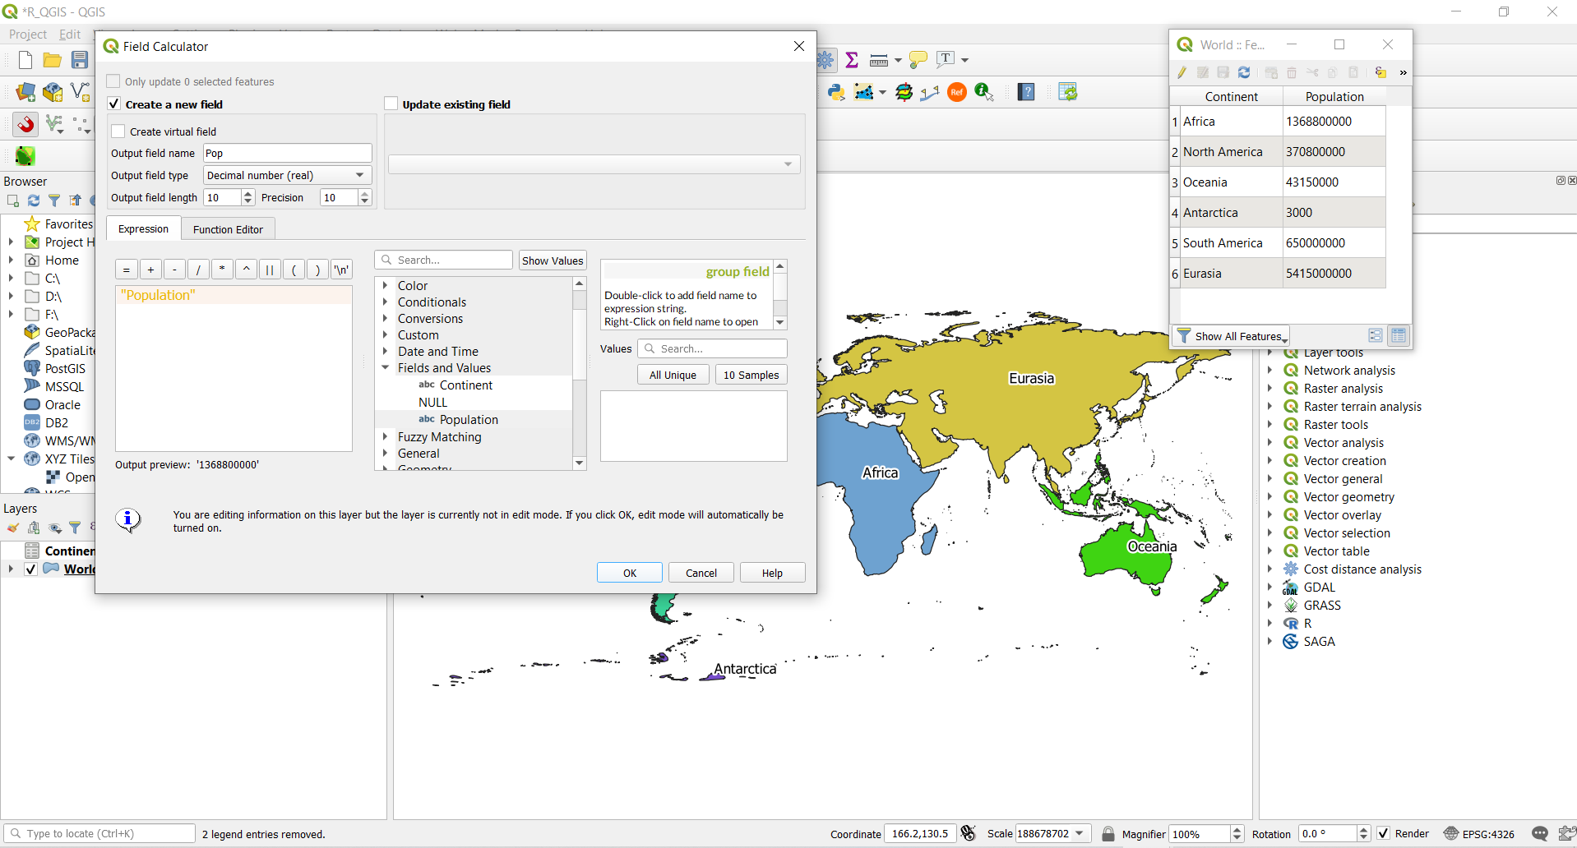
Field Calculator
The field calculator can add new columns/attributes
These new attributes can be base don pre-existing data
Here we are just creating a new column with the same data as ‘Population’, but in a numeric format

Slide 9
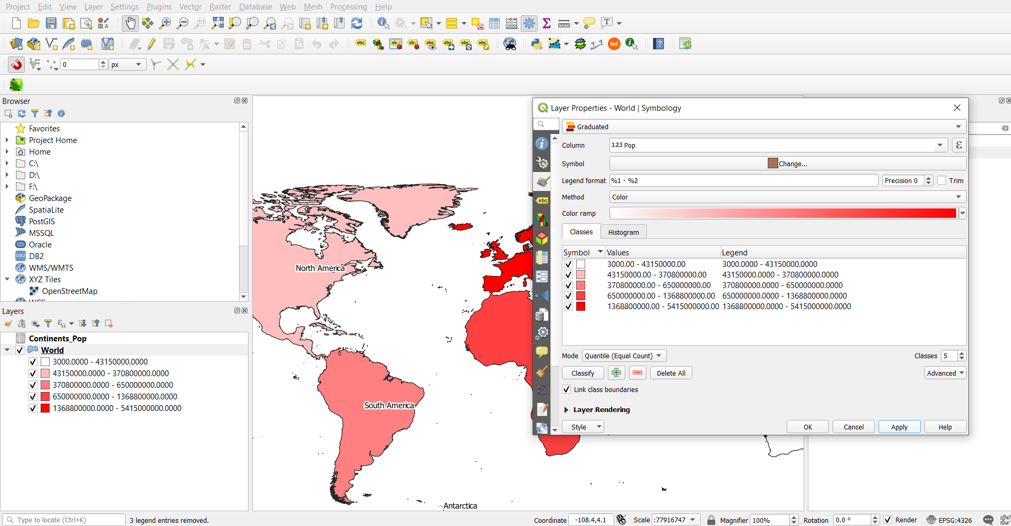
Additional Visualisation
Symbology. Graduated values of colour can be used
Similarly, rule-based labelling allows different labels (or label formatting) depending on the value of certain attributes

Slide 10
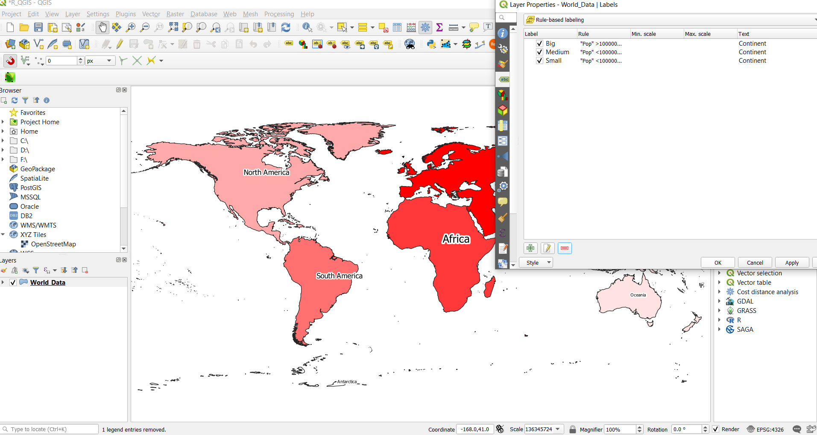
Additional Visualisation
Symbology. Graduated values of colour can be used
Similarly, rule-based labelling allows different labels (or label formatting) depending on the value of certain attributes

Slide 11
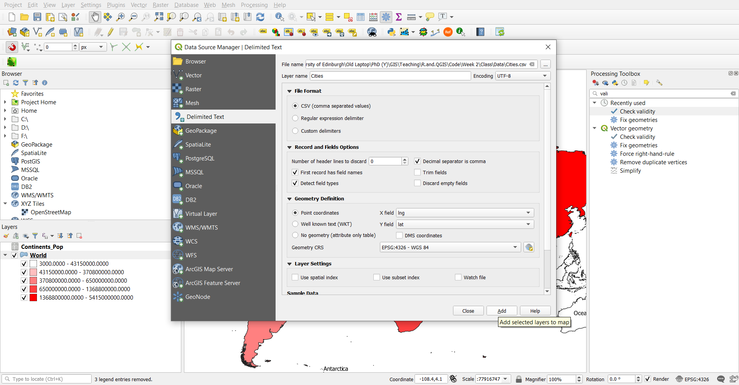
Additional Visualisation
We can add some cities point data by creating a new shapefile from Cities.csv

Slide 12
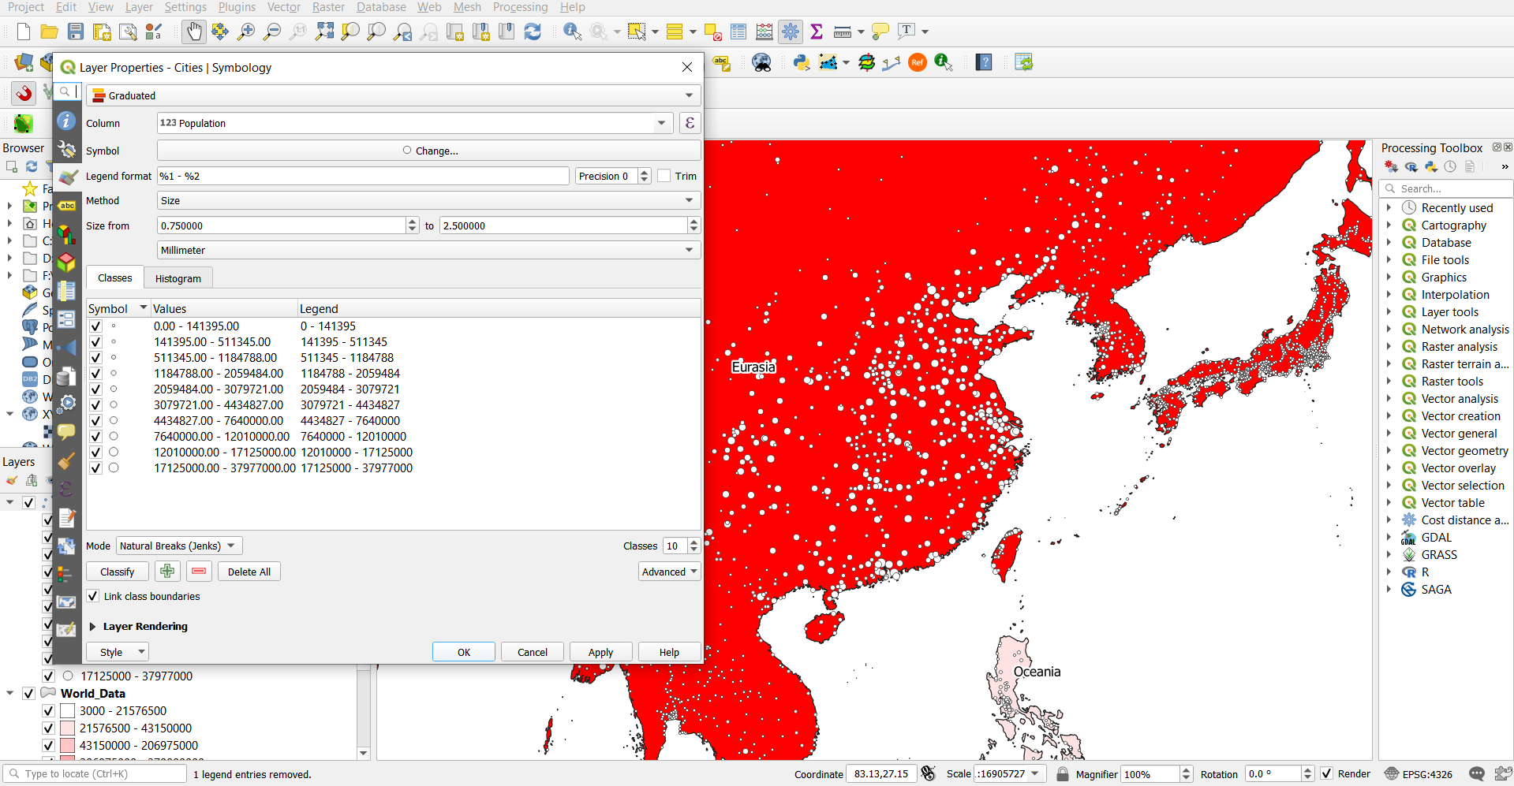
Additional Visualisation
We can add some cities point data by creating a new shapefile from Cities.csv (change the method to ‘Size’)

Slide 13
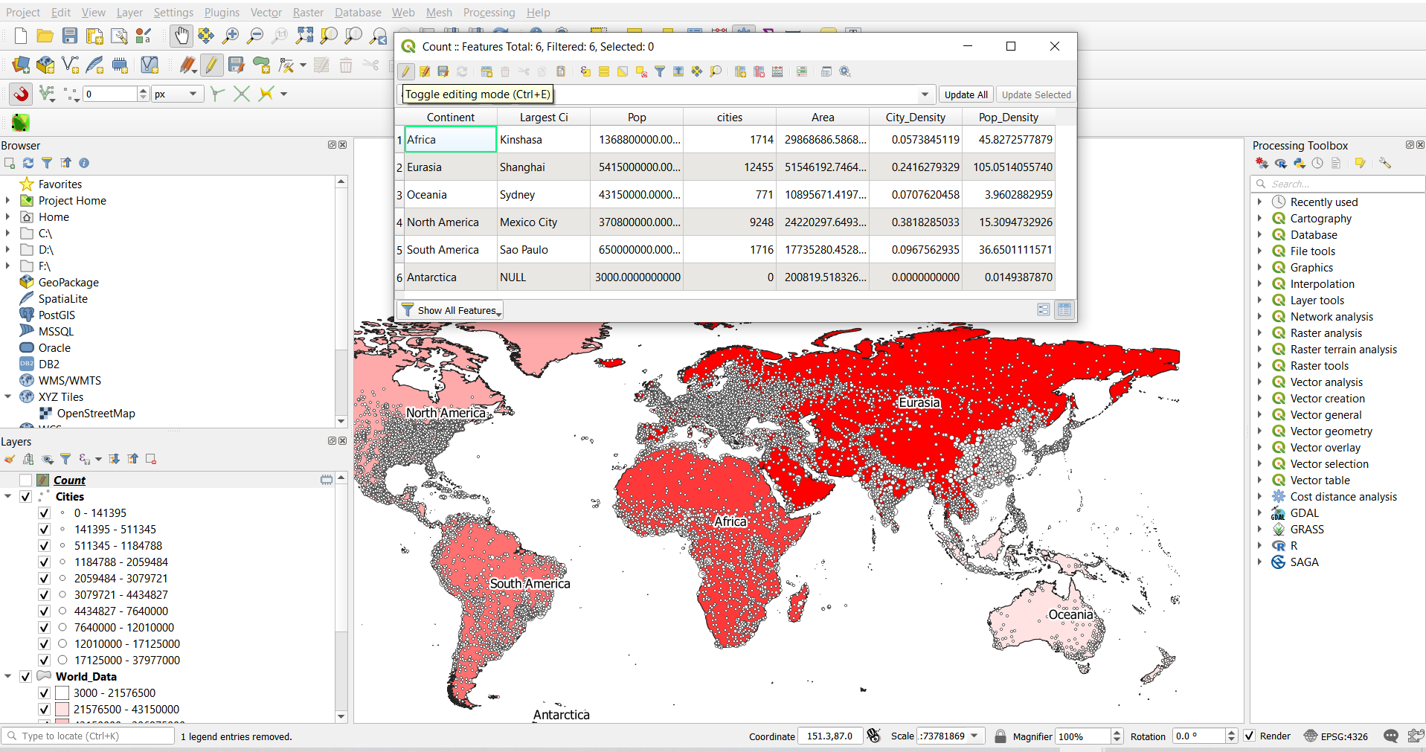
Beyond Visualisation
In QGIS we can not only visualise statistical data, but manipulate and generate new data
City counts for each continent
Or we can calculate area ($area) and get some density data

Slide 14
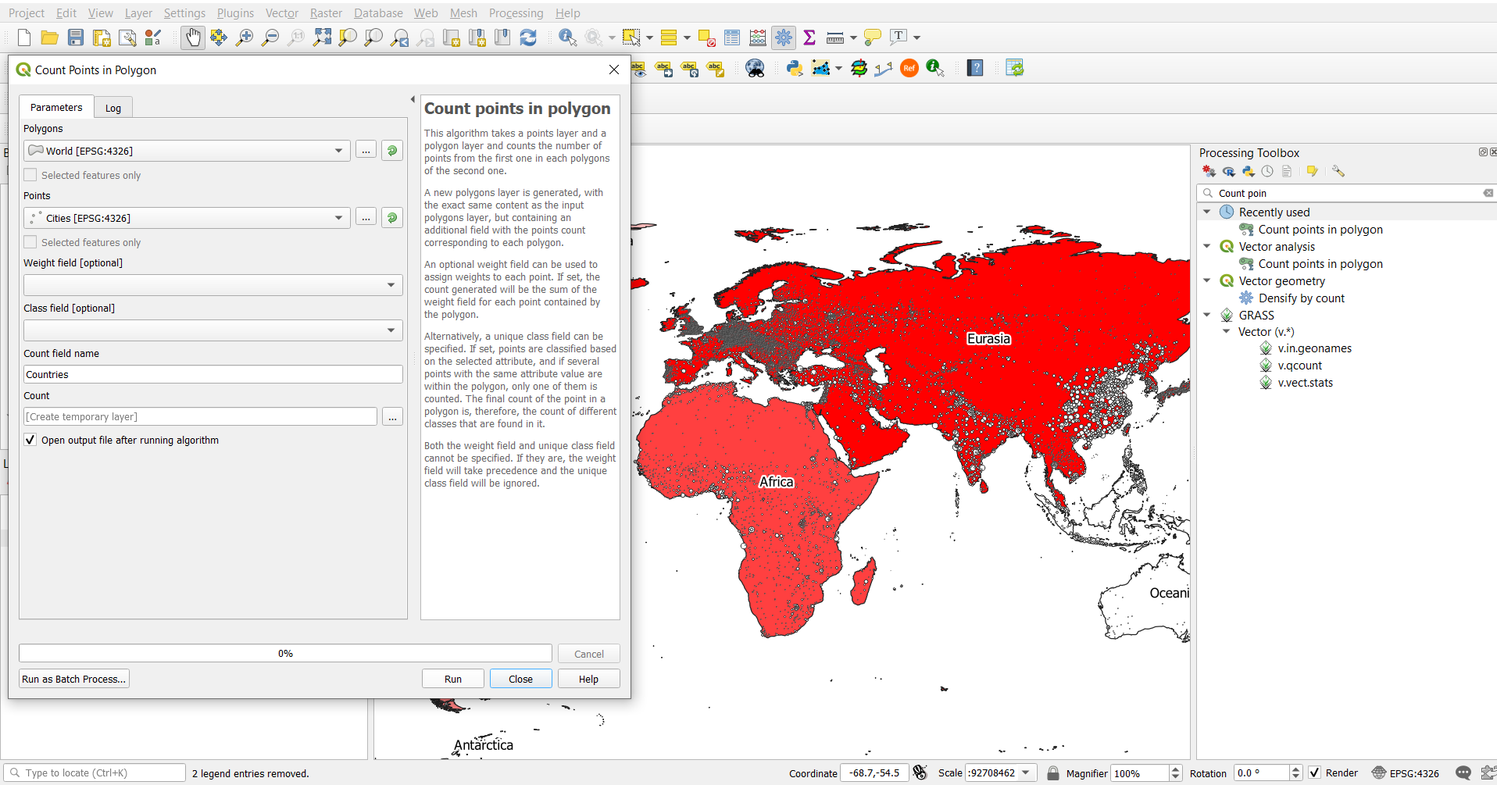
Beyond Visualisation
City counts for each continent
This will create a new polygon shapefile (‘Count’ by default)
The cities column can then be joined with World.shp

Slide 15
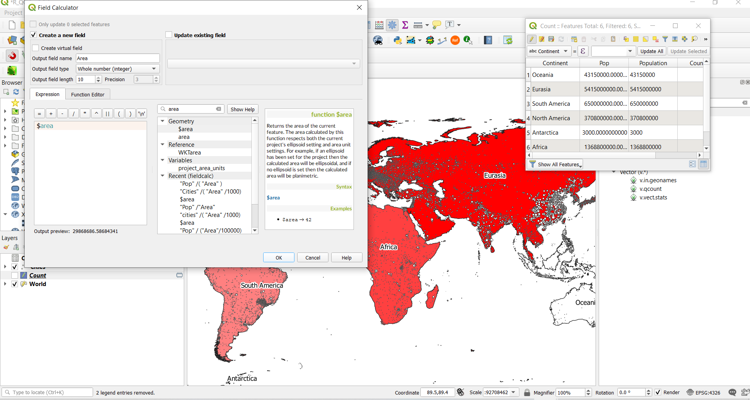
Beyond Visualisation
Or we can calculate area ($area) and get some density data
You can set the units of length and area in project settings (km here)

Slide 16
Beyond Visualisation
To get the density data, we simply need to divide the Pop or Cities by the area (and divide area so we get cites per 1000km² etc.)
("cites"/("Area"/1000))

Slide 17
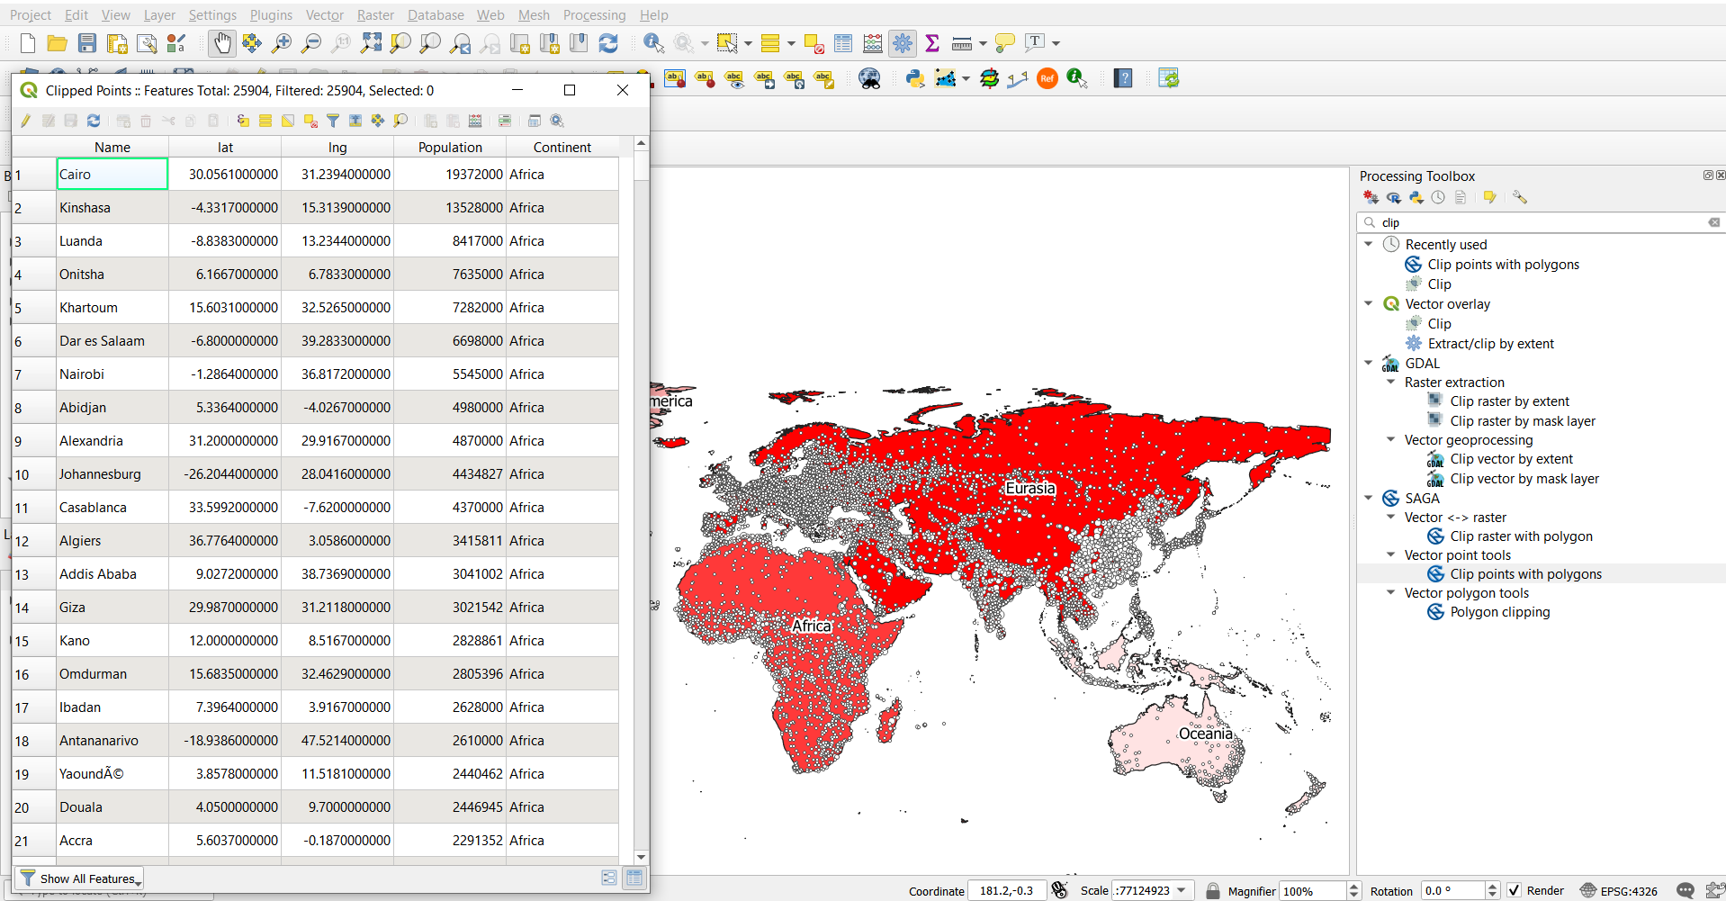
Beyond Visualisation
We can also do this the other way round, adding attributes from polygons to points within them

Slide 18
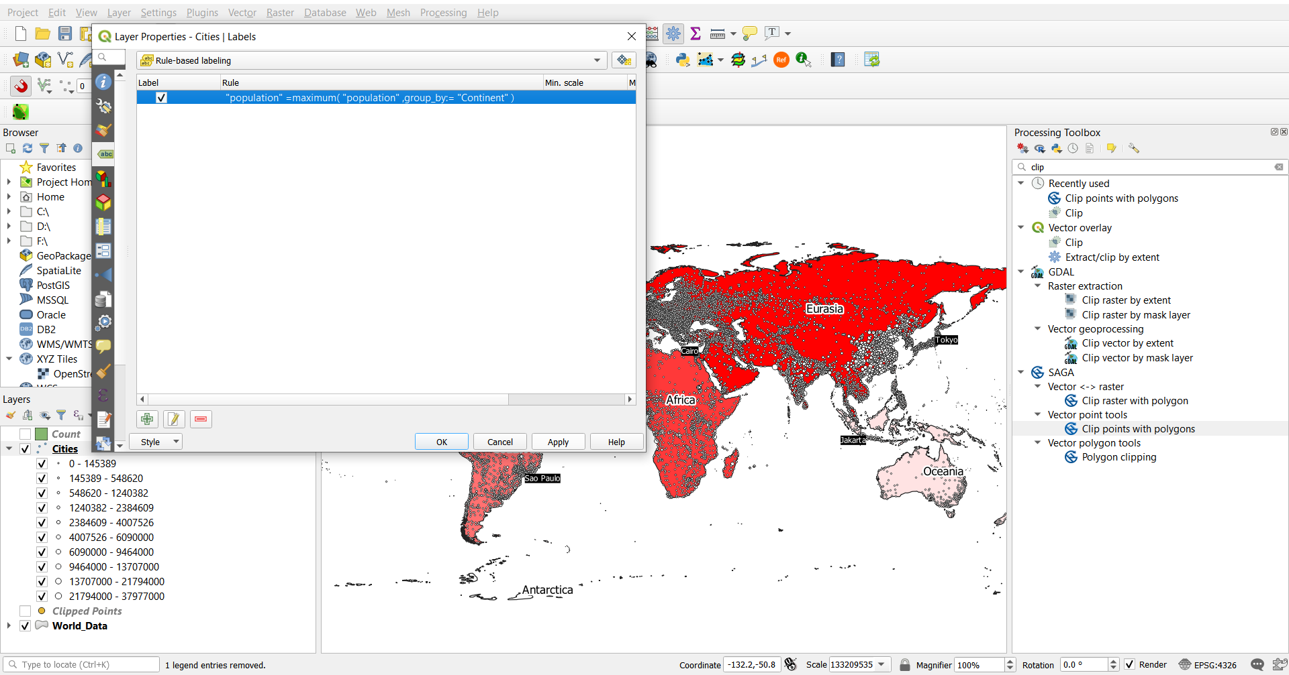
Visualisation
After joining the relevant attributes, we can then use rule based labelling to show the largest city on each continent using the new data
"Pop"=maximum("Pop", group_by:="Continent")

Slide 19
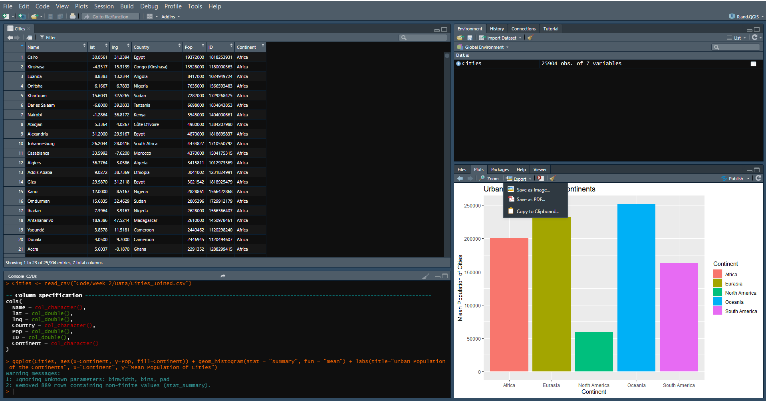
Exporting New Data
This new data can then be exported as a shapefile, .csv or all joined together and exported for further analysis or statistical visualisation (in R for example)

Slide 20
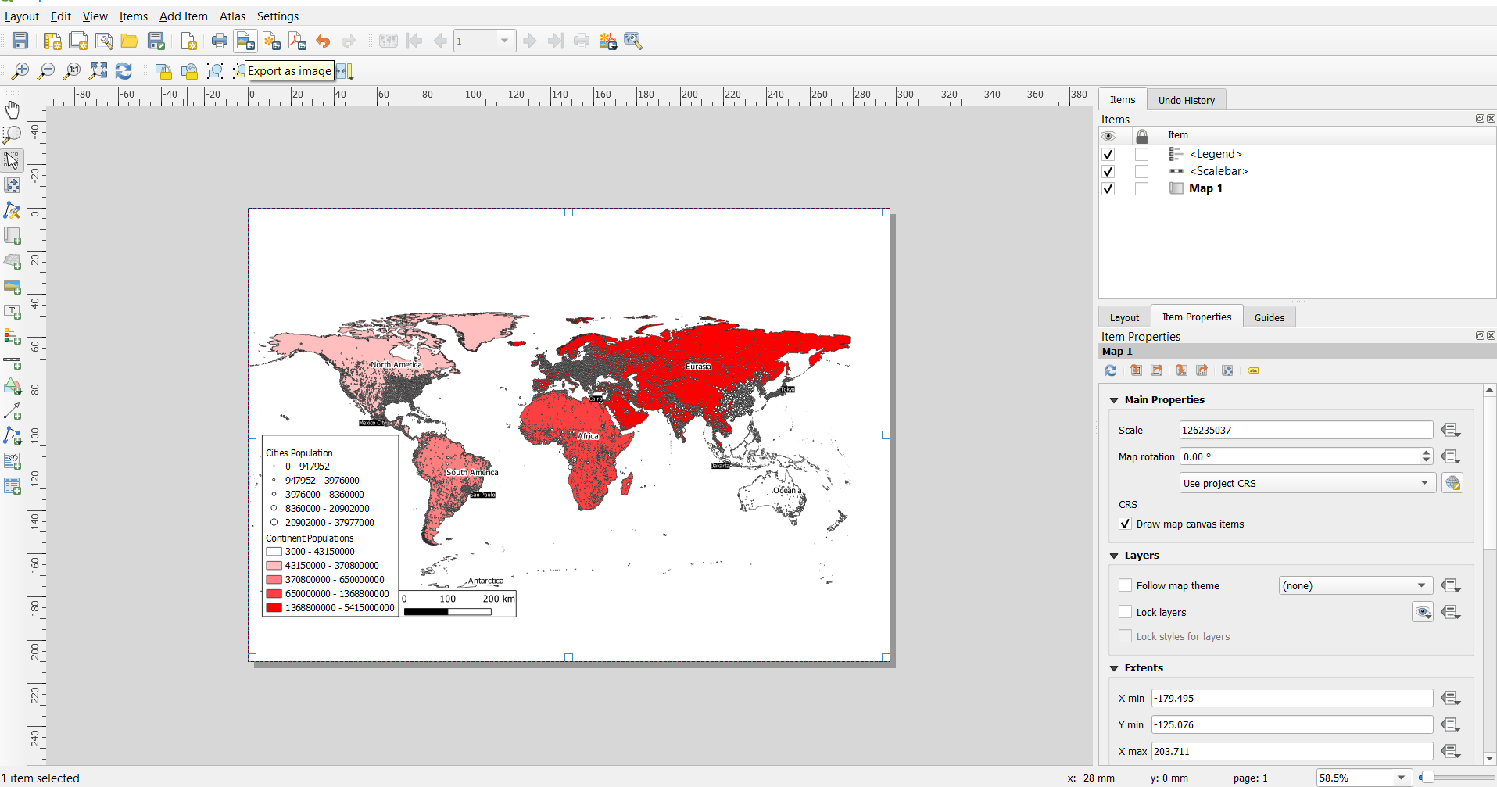
Exporting New Data
It can also be exported as a map image through QGIS
Adding scalebars and legends

Slide 21

Python
Much of the underlying code used in QGIS is in python
https://www.dataquest.io/blog/python-vs-r/

Slide 22
There is much more to statistical data in QGIS
Any questions?

